Slide 1
Island Policy in Finland

Slide 2
Island policy in Finland

Slide 3
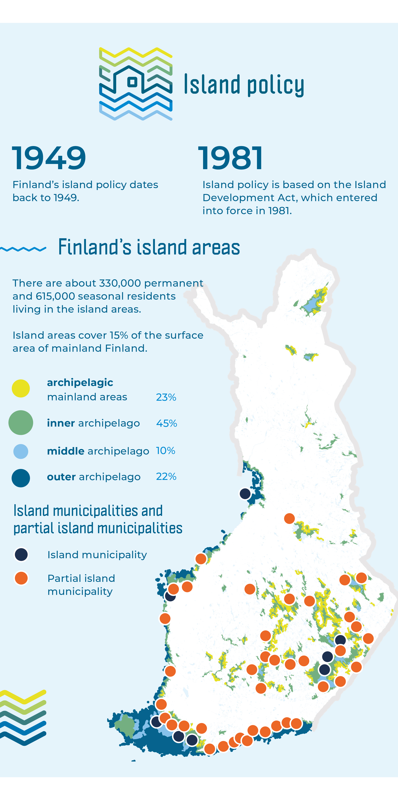
The Finnish Archipelago in Numbers
There are about 200 000 islands in Finland (most islands are small, less than half hectare). Island areas cover 15 % of the surface area of mainland Finland.
Archipelago exists both in marine and lake areas.
Finland has coastline 315 000 kilometres: 46 000 kilometres of coastline are at sea and 215 000 kilometres in lake areas, 54 000 kilometres coastline of rivers.
There are about 20,000 inhabited islands without a fixed road connection to mainland in Finland. Out of these, about 500 are full-time and 19 500 are part-time inhabited islands. There are a total of 1,050 permanently inhabited islands in Finland.
About 330 000 permanent and 600 000 seasonal residents live in the island areas (in the islands and the archipelagic mainland areas, areas which are fragmented by waterways, particularly in lake regions.). (Finland's population is approximately 5.5 million)
About 8,700 people live permanent in the islands with no fixed road connection. (Connection to the mainland is by ferries, commuter vessels or private cable ferries.)
Based on the Island Development Act, the Government designates municipalities where the island circumstances constitute a significant obstacle to their development as island municipalities or partial island municipalities. Island municipalities and partial island municipalities receive supplementary grants for island areas as government transfers.

Slide 4
Island policy system in Finland
Island policy is the oldest form of organised regional policy; it dates back to 1949. The other two are urban policy and rural policy. Island policy works closely with rural and regional policy.
Today’s island policy is based on the Island Development Act adopted in 1981. (The Island Act is currently being reformed.)
Island policy highlights the island areas and their special characteristics in decision-making processes. The aim is to ensure smooth everyday living and a good life in island areas for both permanent and holiday residents.
The key priorities of island policy are:
    Connections and mobility
    Livelihoods and services
    Island culture
    Nature and the environment
    Security (internal and external)
Island policy development work is carried out by the Island Committee and its secretariat. The responsibility for island policy rests with the Ministry of Agriculture and Forestry.

Slide 5
What is Island Committee?
The Island Committee is appointed by the Government and its activities are based on the Island Development Act.
The Island Committee is a parliamentary body that is appointed for each government term.
The Island Committee has a secretariat whose members represent the ministries, Government agencies and institutes, Regional Councils, municipalities, non-governmental organizations and commercial operators.
The Committee holds about 8 meetings per year.
The Island Committee gives statements and opinions and carries out small-scale research and survey projects. The Committee has its own budget (230 000e per year).
The Island Committee prepares the National Archipelago Programme. The programme supports the development of island areas at the national and regional level (municipalities and regions).

Slide 6
Network of islanders
The Island Committee finances the network of islanders in 2024-2027.
The aim is to strengthen dialogue between the Committee and islanders.
The network brings together islanders from all parts of Finland, both marine and lake areas.
The network carries out the tasks assigned to the Island Committee by the Government. An important task is to implement the objectives of the national Island Programme.
The network has two coordinators who are responsible for the network's activities.

Slide 7
National Archipelago Programme

Slide 8
National Archipelago Programme
The Island Committee prepares the National Archipelago Programme. The National Archipelago Programme guides the development of Finland’s archipelago areas.
The programme provides the strategic framework for island policy and also serves as a key instrument for its implementation. The programme supports the development of island areas at the national and regional level (municipalities and regions).
Archipelago Programmes have been prepared since 1995, and the current programme is the seventh in the series.
The four strategic objectives of the current programme:
  The archipelago is physically and digitally accessible.
  Services in the archipelago have been ensured.
  The archipelago is a diverse environment for practising economic activities.
  Nature and the environment of the archipelago are doing well.
The new Island Committee will be appointed after the parliamentary elections next spring and we are currently starting to prepare the next National Archipelago programme. The aim is to ensure that the programme is aligned with the new EU Islands Strategy.

Slide 9
Island Development Act

Slide 10
Reform of the Island Act
The Act has not been updated since 1981. In many respects the Act is outdated. Some sections are technically old and the operating environment has also changed a lot over the past 45 years.
Reform the Island Act is included in the current Government Programme.
A working group has been preparing the reform of the Island Act. The working group consists of representatives from almost all ministries (Ministry of Finance, Ministry of Economic Affairs and Employment, Ministry of Education and Culture, Ministry of the Interior, Ministry of Social Affairs and Health and Ministry of the Environment) and representatives of local authorities.
The proposal has been presented to the Government on 15 September. It will then be considered by Parliament 7 October. During the parliamentary process, Parliament will hear experts on matters related to the content of the Act.
The aim is for the new Act to enter into force at the beginning of 2027.

Slide 11
The most significant changes
Purpose of the Act is to create the conditions for strengthening the vitality of the archipelago, supporting living in the archipelago—both permanent and seasonal—and safeguarding cultural heritage and natural values.
The aim is to ensure that the special circumstances of archipelago areas are better taken into account in decision-making. There are two sections in the Act related to this:
  Consideration of Archipelago Vitality and Special Characteristics: The vitality and special characteristics of the island must be taken into account in planning and decision-making concerning the island.
  Archipelago Situation and Development Overview; The Government must regularly provide Parliament with an overview of the progress of policy measures concerning the archipelago, significant developments related to those measures, and an assessment of their impacts.
Security issues are also included in the Act:
  Obligation to Prepare for Disruptions in Ferry Services: A ferry service provider shall prepare for emergencies and disruptions in normal conditions and ensure that the service provider continues its operations as smoothly as possible during emergencies and disruptions in normal conditions.
The Act also recognizes seasonal residents, not only permanent residents, for example in the planning of archipelago transport services.

Slide 12
Island Committee’s objectives for the next government term

Slide 13
Island Committee’s objectives for the next government term
The parliamentary elections will be held in Finland next spring
The Island Committee has prepared its objectives for the next government term (each objective is accompanied by a set of more detailed sub-objectives):
  Accessibility to the archipelago must be ensured by land, sea and digital connectivity
  A safe archipelago requires functional services, strong preparedness, and adequate resources
  Services must be safeguarded in the archipelago through local, mobile, and digital solutions
  From visibility in statistics to a stronger voice in decision-making: multi-local living must be recognized

Slide 14
Island Security Days
The Island Committee will organize “the Island Security Days” at Parliament in November.
First day the Committee invites children from the island areas to visit the Parliament and to have discussions with Members of Parliament.
On the second day, a seminar will be held to highlight issues related to the security and resilience of everyday life in the archipelago, including the reliability of internet and telephone connections, the role of volunteer fire brigades in archipelago areas, and the importance of local communities' preparedness. The Island Committee will present its objectives for the upcoming Government Programme. In addition, a meeting of safety and security stakeholders will be organised, bringing together representatives from the Finnish Border Guard, the Maritime rescue association, volunteer fire brigades, the Finnish Defence Forces, volunteer rescue organisations, volunteer oil spill response teams, and archipelago residents.
On the third day, policy discussions will be held on the accessibility of the archipelago and the importance of voluntary work.
The aim is raise awareness of island issues among Members of Parliament!

